Slide 1
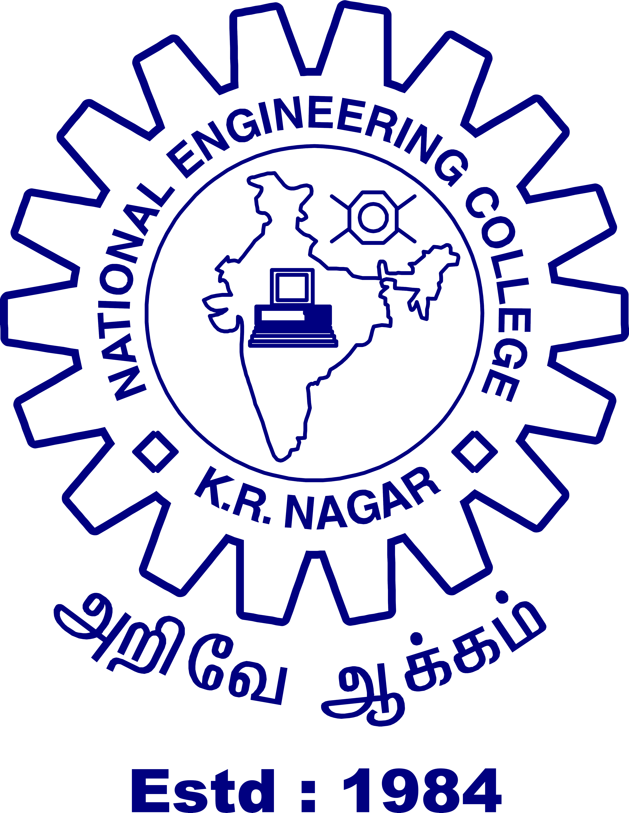
NATIONAL ENGINEERING COLLEGE, KOVILPATTI
(An Autonomous Institution Affiliated to Anna University, Chennai)
DEPARTMENT OF ELECTRONICS AND COMMUNICATION ENGINEERING
23EC64C – PRODUCT DEVELOPMENT AND PRACTICE
Hybrid Energy Harvesting System Using Train-Induced Vibration And Airflow In Railway Tunnels
Team Members
Mentors
DHANUSH S (2311030)
SATHISH KUMAR V (2311112)
AROCKYA ABINESH A (2311123)
MRS. E. KIRTHIGA @ SRIDEVI M.E.,
ASSISTANT PROFESSOR

Slide 2
OUTLINE
2
Objectives
Literature Survey
Patent Survey
Problems in the Existing Solution
Proposed Methodology
Results and Discussion
Conclusion & Future Direction

Slide 3
OBJECTIVES
3
1. To Harvest Energy from Train-Induced Vibration
Harvest electrical energy from train-induced vibrations using piezoelectric sensor systems.
2. To Generate Energy from Airflow in Tunnels
Generate electrical power from strong tunnel airflow using micro wind turbine systems.
3. To Develop a Hybrid Energy System
Develop a hybrid system combining vibration and airflow energy sources efficiently.
4. To Store and Manage Generated Energy Efficiently
Store generated energy effectively using rechargeable batteries with proper charging circuits.
5. To Provide Self-Powered Tunnel Lighting System Provide automatic tunnel LED lighting using stored renewable energy for improved visibility.

Slide 4
LITERATURE SURVEY
4
S.No. | Title of the Research Article | Journal Name & Publication Year | Description
1) | A review of vibration energy harvesting in rail transportation field | Iscience - 2022 | A 2022 iScience research article focusing on advanced energy harvesting techniques using piezoelectric materials.
2) | Piezoelectric energy harvesting in railways: Current status and future challenges | Energy Strategy Reviews - 2025 | A 2025 Energy Strategy Reviews article analyzing modern strategies for sustainable energy generation and management.
3) | Vibration energy harvesting from railway tracks via a magnetic-piezoelectric system | Smart Materials and Structures - 2025 | This 2025 study proposes a magnetic–piezoelectric system to harvest energy from railway track vibrations.
4) | Hybrid energy harvesting using combined piezoelectric and electromagnetic conversion | Energy Conversion and Management - 2018 | A 2018 Energy Conversion and Management study on efficient methods of harvesting and converting mechanical energy into electricity.
5) | Piezoelectric energy harvesting in railways: Current status and future challenges | Energy Strategy Reviews - 2025 | This 2025 study reviews piezoelectric energy harvesting techniques for converting mechanical vibrations into electrical energy.

Slide 5
PATENT SURVEY
5
S. No. | Patent Title | Country & Grant Year | Description
1) | Method and system for energy harvesting | United states(US)-2013 | A system that harvests mechanical energy from vehicles using piezoelectric devices and generators.
2) | Energy harvesting system, apparatus and method | United states(US)-2006 | A system that converts acoustic (sound) energy into electrical energy using piezoelectric devices for sensors.
3) | Vibration energy harvesting and management for wireless sensor networks in bridge structural monitoring | United states(US)-2005 | An IEEE research paper presenting a technological approach for efficient energy harvesting and system optimization.
4) | Energy harvesting from loudspeaker vibration | WIPO-2020 | Energy harvesting from loudspeaker vibration

Slide 6
PROBLEMS IDENTIFIED IN EXISTING SOLUTIONS
6
Conventional Tunnel Lighting Systems Uses electricity from the power grid with fixed lights installed inside the tunnel. Consumes more energy and requires high wiring and maintenance cost.
Basic Energy Harvesting Systems Some systems use single-source harvesting (only vibration or only airflow), but
not hybrid integration.
Battery Energy Storage Systems (BESS)
Large battery banks store external electricity and supply power to tunnel lights
when required.
Smart LED Lighting Systems Uses energy-efficient LED lights with automatic control systems. Reduces power consumption but still depends on external electricity supply.

Slide 7
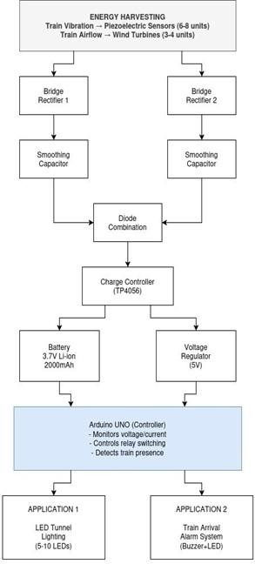
PROPOSED METHODOLOGY
7
BLOCK DIAGRAM

Slide 8
PROPOSED METHODOLOGY
8
UNIQUE/ INNOVATIVE FEATURES
Hybrid energy generation using both vibration and airflow from train movement.
Self-powered tunnel lighting system with no external electricity requirement.
Automatic energy generation triggered only during train entry and exit.
Integration of real-time monitoring using Arduino and IoT-based control (Internet of Things).
Scalable design suitable for real railway tunnels and smart transportation systems.

Slide 9
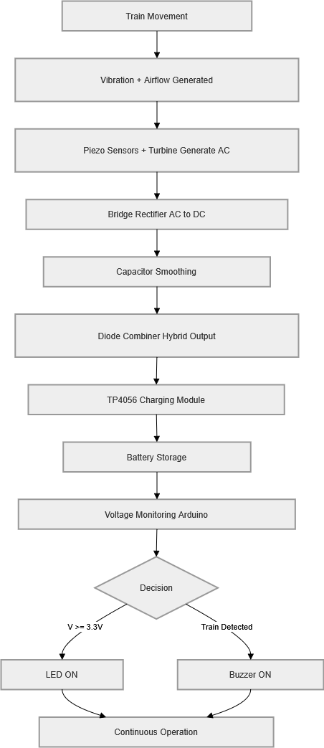
PROPOSED METHODOLOGY
9
FLOW CHART / SIGNAL FLOW GRAPH / ALGORITHM

Slide 10
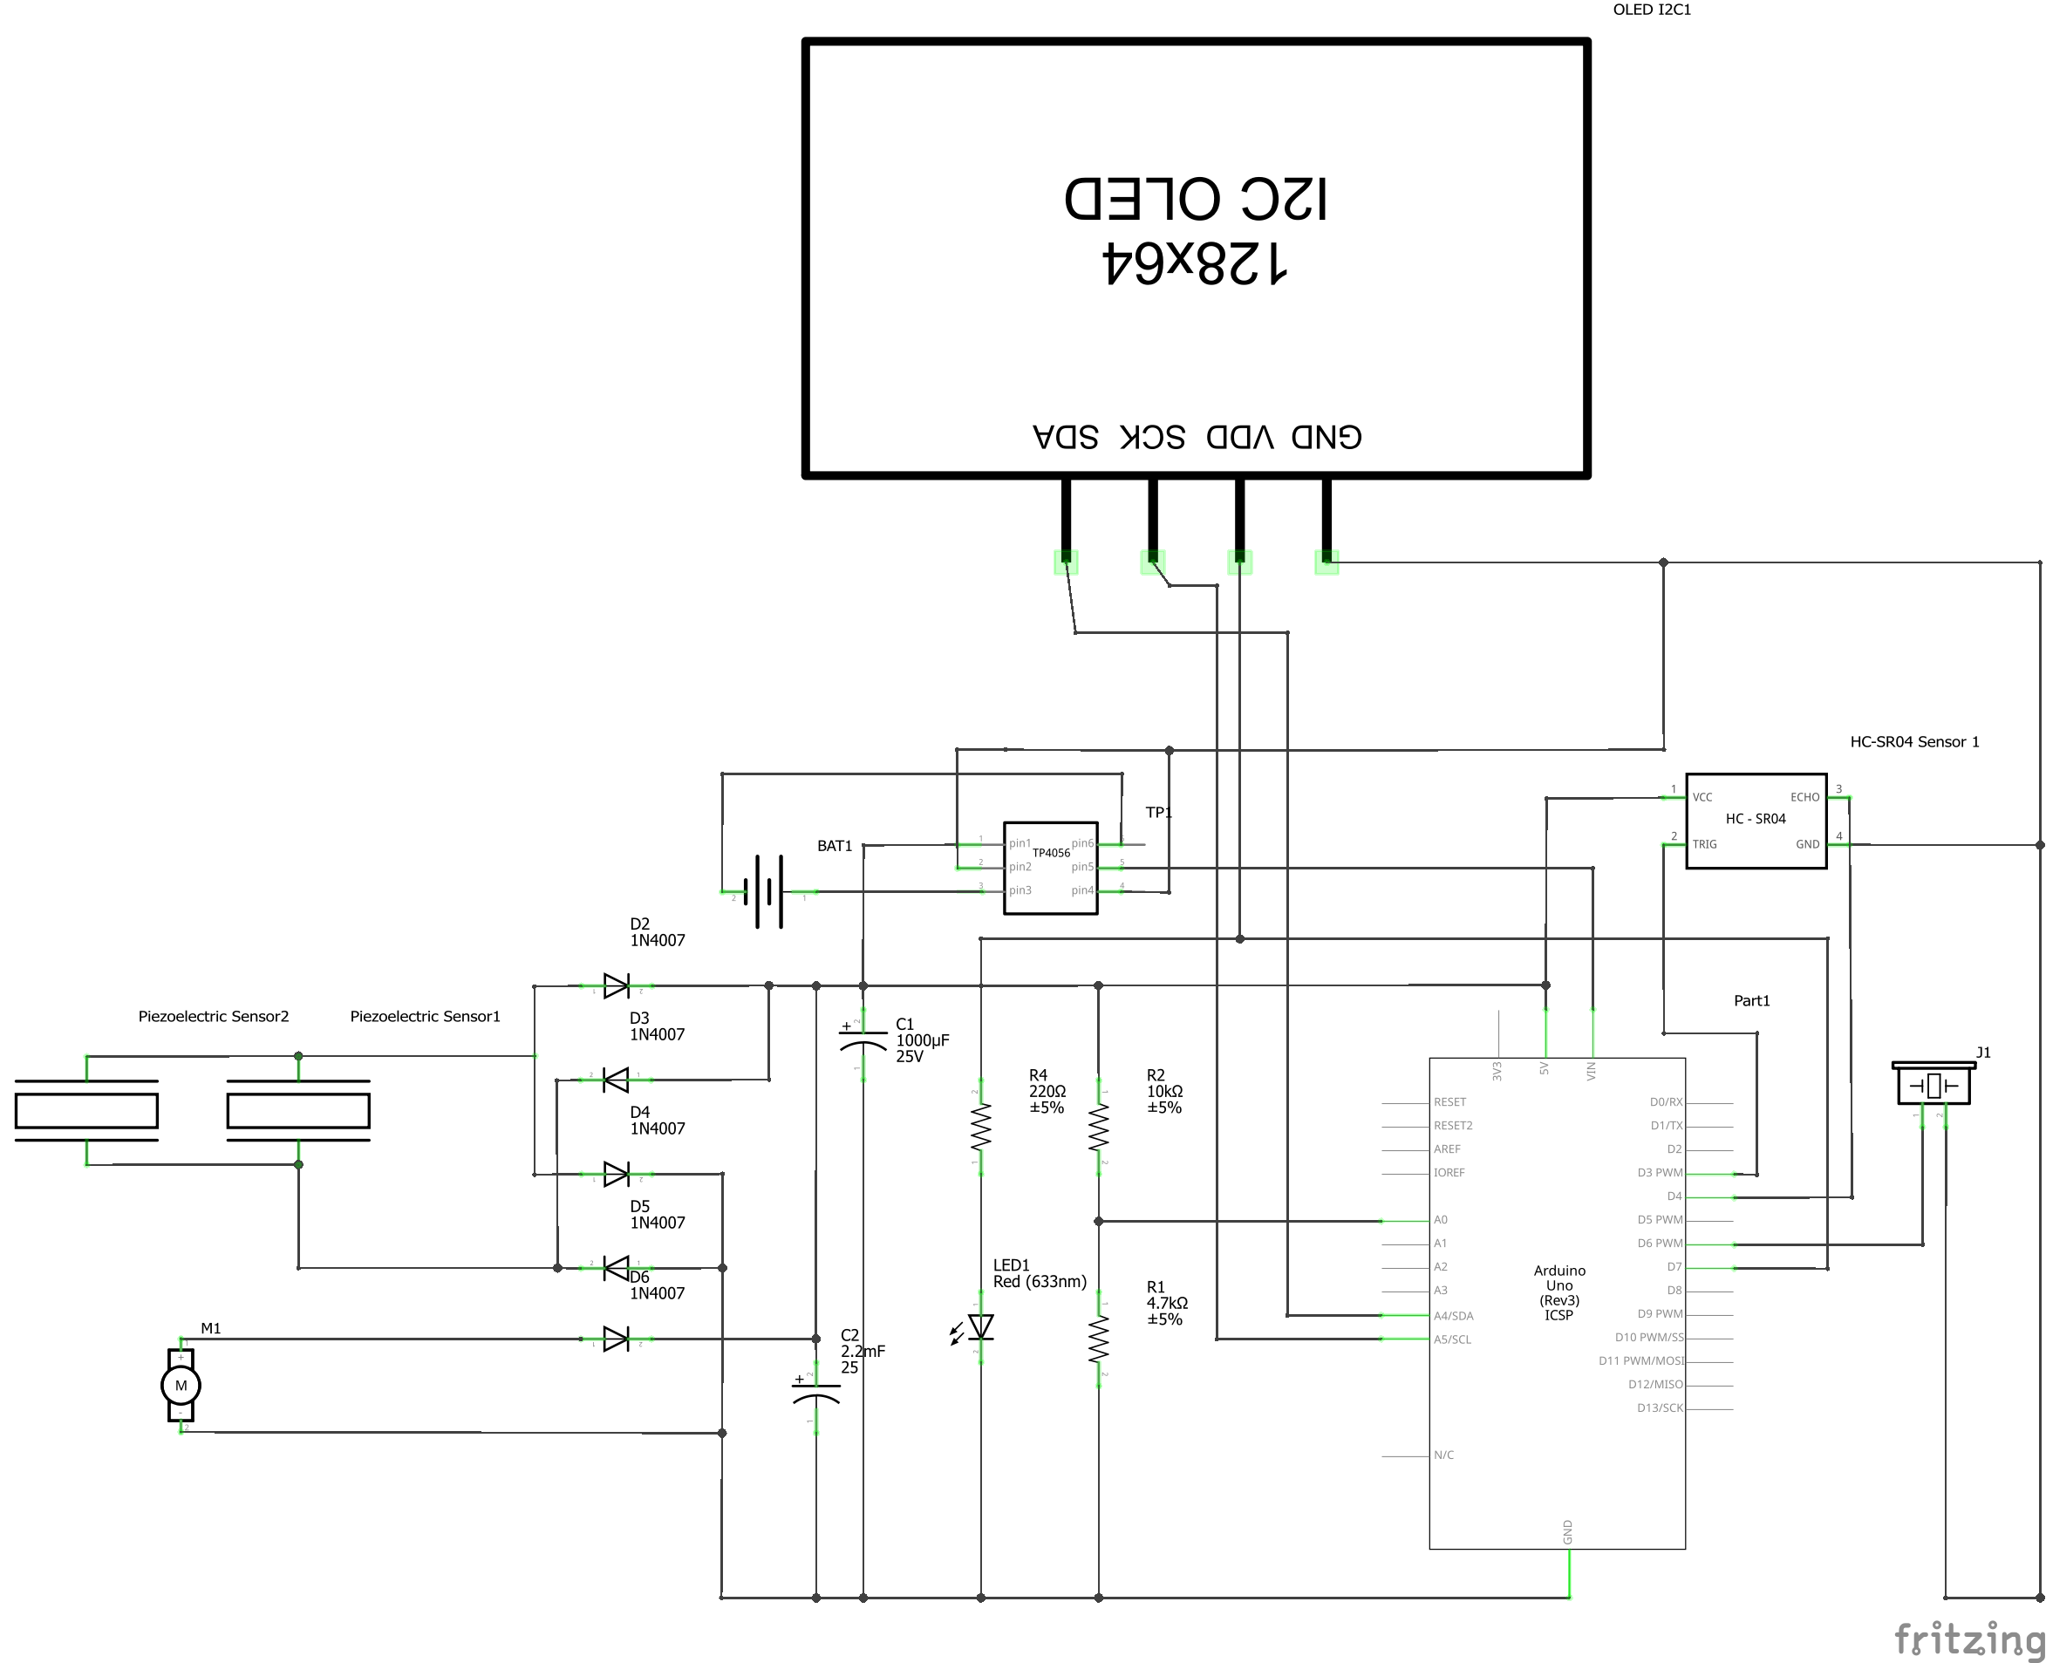
PROPOSED METHODOLOGY
10
CIRCUIT DIAGRAM

Slide 11
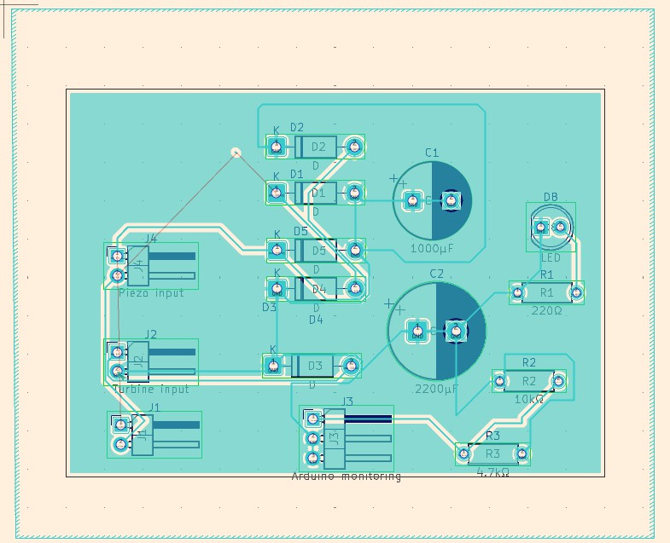
PROPOSED METHODOLOGY
11
PCB LAYOUT DESIGN

Slide 12
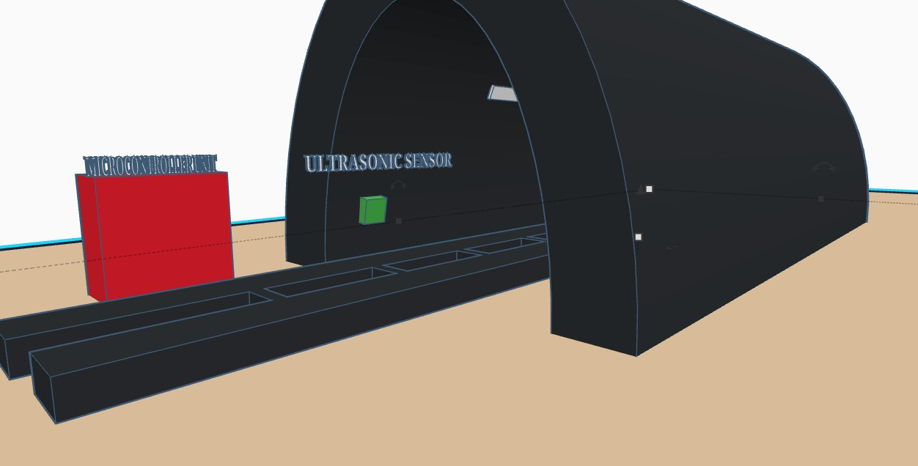
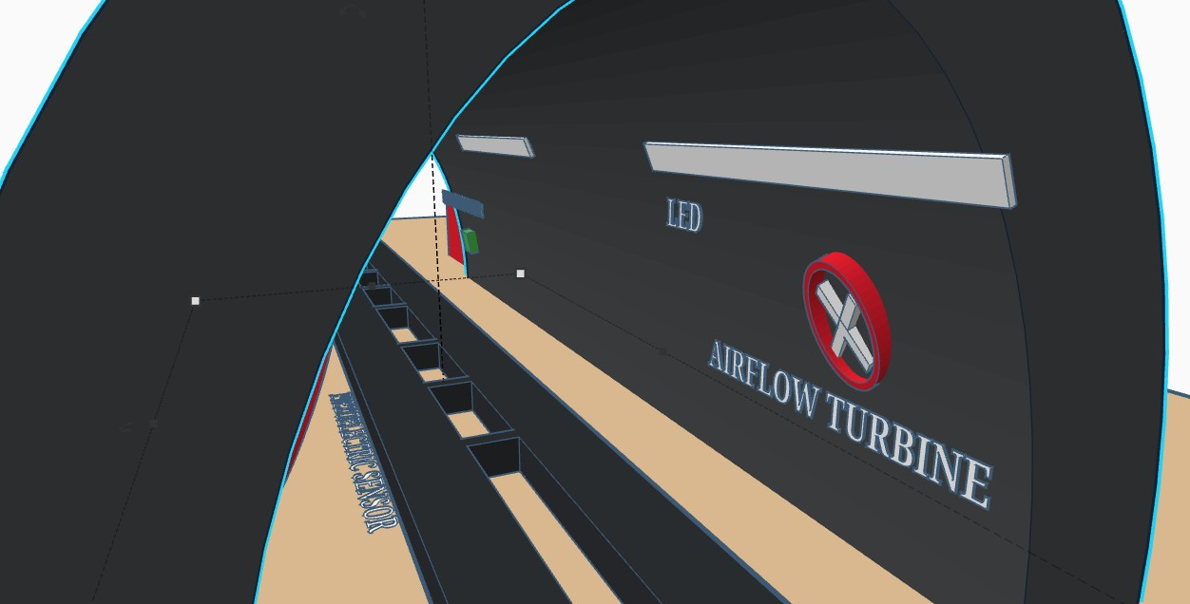

PROPOSED METHODOLOGY
12
3D CAD MODELLING OF ENCLOSURE
FRONT VIEW
BACK VIEW
SIDE VIEW

Slide 13
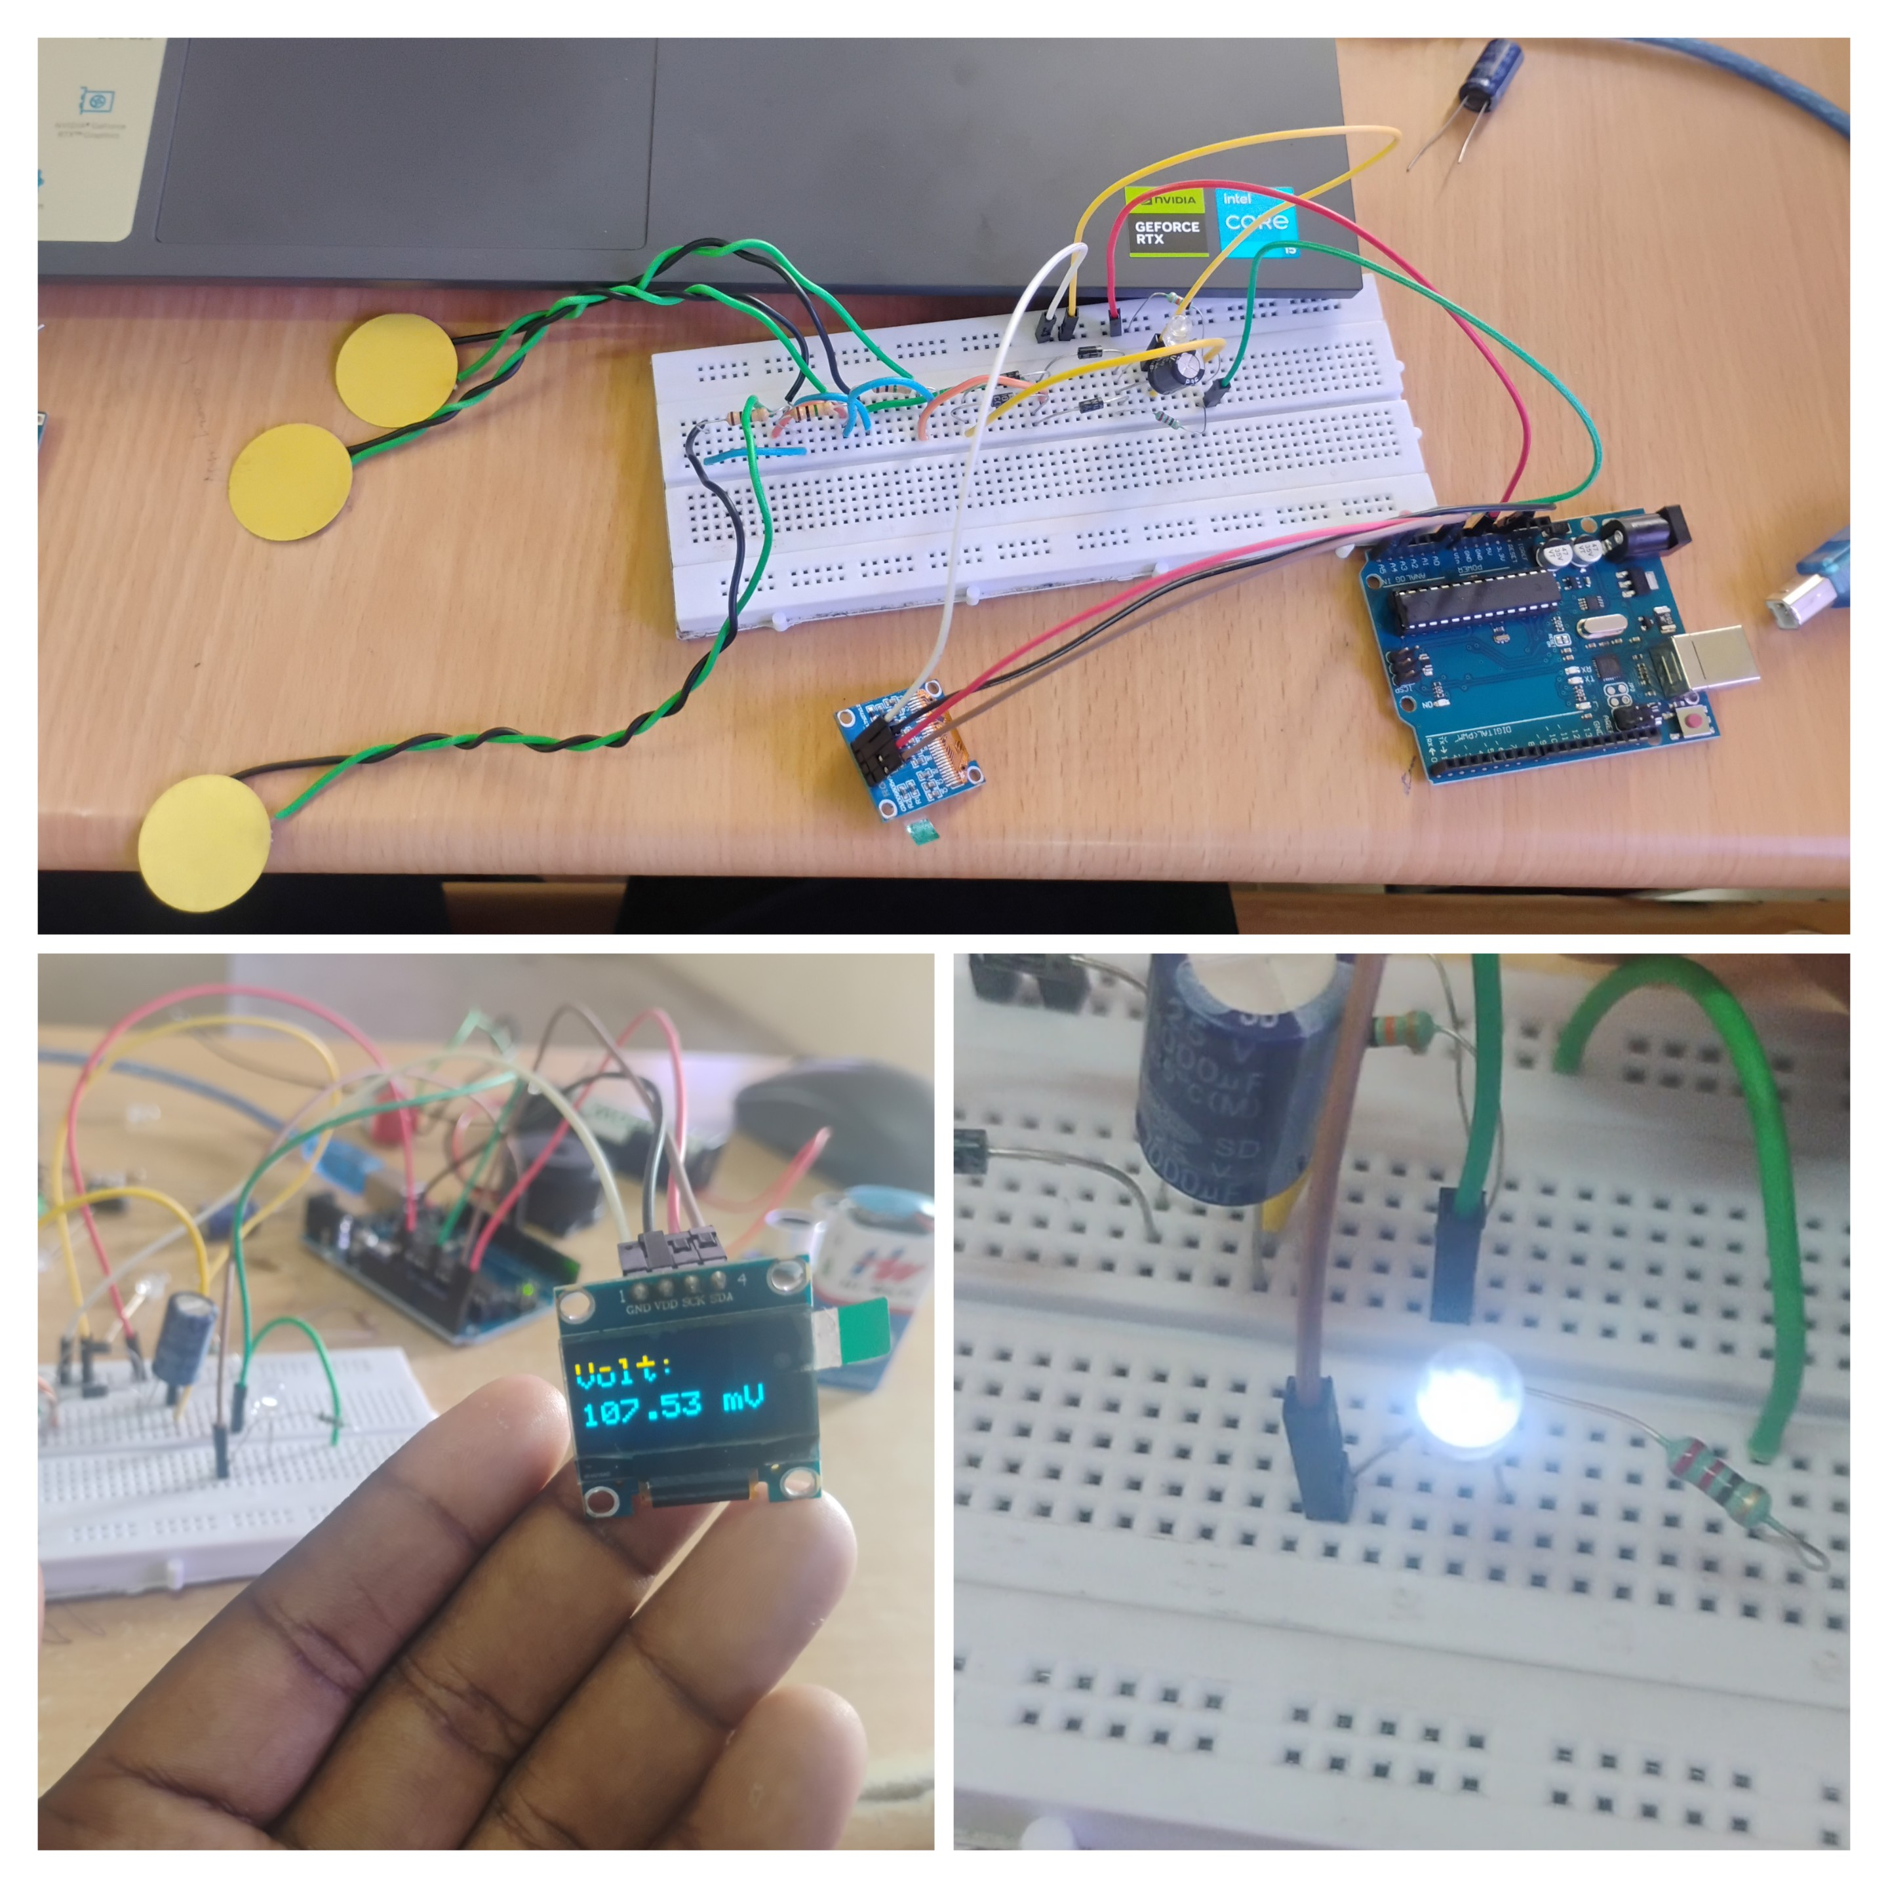
PROPOSED METHODOLOGY
13
PROTOTYPE PHOTOGRAPH

Slide 14
PROPOSED METHODOLOGY
14
DISCUSSION AND RESULTS
The prototype successfully demonstrated hybrid energy generation from both vibration and airflow when the train passed through the tunnel.
It was observed that airflow-based generation produced relatively higher and more stable voltage compared to vibration-based piezo output.
The combined (hybrid) output showed improved energy availability, confirming the effectiveness of using multiple energy sources together.
The stored energy was sufficient to power tunnel LEDs for a short duration, proving the feasibility of a self-powered lighting system.
The results indicate that with real trains (higher speed and force), the system can generate significantly higher energy, making it suitable for practical implementation.

Slide 15
CONCLUSION & FUTURE DIRECTIONS
15
The proposed system successfully demonstrates that train-induced vibration and airflow can be effectively converted into usable electrical energy.
The prototype proves the feasibility of a self-powered tunnel lighting system without relying on external power sources.
Hybrid energy harvesting improves efficiency compared to using a single energy source alone.
In future, higher-efficiency generators and optimized turbine designs can significantly increase energy output.
The system can be further enhanced using smart monitoring and Internet of Things for large-scale real-world railway applications.

Slide 16
Thank You

